Slide 1
Sending frame – Hop to Hop
If a message from an application from one end to other end has to reach across a network, first step is to send this message to the adjacent node( hop-to-hop)connected on the physical link.
At Link layer level, a frame has to be prepared and to be sent to adjacent node.
Frame must have Source MAC address and Destination MAC address.
But how does the source host know the MAC address of the destination ??

Slide 2
Solution is Address Resolution Protocol

Slide 3
MAC Addresses and ARP
32-bit IP address:
network-layer address
used to get datagram to destination IP subnet
MAC (or LAN or physical or Ethernet) address:
function: get frame from one interface to another physically-connected interface (same network)
48 bit MAC address (for most LANs)
burned in NIC ROM, also sometimes software settable

Slide 4
LAN Addresses and ARP
Each adapter on LAN has unique LAN address
1A-2F-BB-76-09-AD
Broadcast address =
FF-FF-FF-FF-FF-FF
LAN
(wired or
wireless)
= adapter
71-65-F7-2B-08-53
58-23-D7-FA-20-B0
0C-C4-11-6F-E3-98

Slide 5
LAN Address (more)
MAC address allocation administered by IEEE
manufacturer buys portion of MAC address space (to assure uniqueness)
analogy:
(a) MAC address: like Social Security Number
(b) IP address: like postal address
MAC flat address ➜ portability
can move LAN card from one LAN to another
IP hierarchical address NOT portable
address depends on IP subnet to which node is attached

Slide 6
ARP: Address Resolution Protocol
Question: how to determine
MAC address of B
knowing B’s IP address?
Each IP node (host, router) on LAN has ARP table
ARP table: IP/MAC address mappings for some LAN nodes
< IP address; MAC address; TTL>
TTL (Time To Live): time after which address mapping will be forgotten (typically 20 min)
137.196.7.78
1A-2F-BB-76-09-AD
137.196.7.23
137.196.7.14
LAN
71-65-F7-2B-08-53
58-23-D7-FA-20-B0
0C-C4-11-6F-E3-98
137.196.7.88

Slide 7
ARP protocol: Same LAN (network)
A wants to send datagram to B, and B’s MAC address not in A’s ARP table.
A broadcasts ARP query packet, containing B's IP address
dest MAC address = FF-FF-FF-FF-FF-FF
all machines on LAN receive ARP query
B receives ARP packet, replies to A with its (B's) MAC address
frame sent to A’s MAC address (unicast)
A caches (saves) IP-to-MAC address pair in its ARP table until information becomes old (times out)
soft state: information that times out (goes away) unless refreshed
ARP is “plug-and-play”:
nodes create their ARP tables without intervention from net administrator

Slide 8
Addressing: routing to another LAN
walkthrough: send datagram from A to B via R.
focus on addressing - at both IP (datagram) and MAC layer (frame)
assume A knows B’s IP address
assume A knows B’s MAC address (how?)
assume A knows IP address of first hop router, R (how?)
assume A knows MAC address of first hop router interface (how?)
A
B
R
111.111.111.111
222.222.222.222
74-29-9C-E8-FF-55
49-BD-D2-C7-56-2A
222.222.222.220
1A-23-F9-CD-06-9B
111.111.111.112
111.111.111.110
222.222.222.221
CC-49-DE-D0-AB-7D
E6-E9-00-17-BB-4B
88-B2-2F-54-1A-0F

Slide 9
Addressing: routing to another LAN
A creates IP datagram with IP source A, destination B
A creates link-layer frame with R's MAC address as dest, frame contains A-to-B IP datagram
MAC src: 74-29-9C-E8-FF-55
MAC dest: E6-E9-00-17-BB-4B
IP
Eth
Phy
IP src: 111.111.111.111
IP dest: 222.222.222.222
A
B
R
111.111.111.111
222.222.222.222
74-29-9C-E8-FF-55
49-BD-D2-C7-56-2A
222.222.222.220
1A-23-F9-CD-06-9B
111.111.111.112
111.111.111.110
222.222.222.221
CC-49-DE-D0-AB-7D
E6-E9-00-17-BB-4B
88-B2-2F-54-1A-0F

Slide 10
Addressing: routing to another LAN
frame sent from A to R
frame received at R, datagram removed, passed up to IP
MAC src: 74-29-9C-E8-FF-55
MAC dest: E6-E9-00-17-BB-4B
IP
Eth
Phy
IP src: 111.111.111.111
IP dest: 222.222.222.222
IP
Eth
Phy
A
B
R
111.111.111.111
222.222.222.222
74-29-9C-E8-FF-55
49-BD-D2-C7-56-2A
222.222.222.220
1A-23-F9-CD-06-9B
111.111.111.112
111.111.111.110
222.222.222.221
CC-49-DE-D0-AB-7D
E6-E9-00-17-BB-4B
88-B2-2F-54-1A-0F

Slide 11
Addressing: routing to another LAN
R forwards datagram with IP source A, destination B
R creates link-layer frame with B's MAC address as dest, frame contains A-to-B IP datagram
MAC src: 1A-23-F9-CD-06-9B
MAC dest: 49-BD-D2-C7-56-2A
IP
Eth
Phy
IP
Eth
Phy
IP src: 111.111.111.111
IP dest: 222.222.222.222
A
B
R
111.111.111.111
222.222.222.222
74-29-9C-E8-FF-55
49-BD-D2-C7-56-2A
222.222.222.220
1A-23-F9-CD-06-9B
111.111.111.112
111.111.111.110
222.222.222.221
CC-49-DE-D0-AB-7D
E6-E9-00-17-BB-4B
88-B2-2F-54-1A-0F

Slide 12
Addressing: routing to another LAN
R forwards datagram with IP source A, destination B
R creates link-layer frame with B's MAC address as dest, frame contains A-to-B IP datagram
MAC src: 1A-23-F9-CD-06-9B
MAC dest: 49-BD-D2-C7-56-2A
IP
Eth
Phy
IP
Eth
Phy
IP src: 111.111.111.111
IP dest: 222.222.222.222
A
B
R
111.111.111.111
222.222.222.222
74-29-9C-E8-FF-55
49-BD-D2-C7-56-2A
222.222.222.220
1A-23-F9-CD-06-9B
111.111.111.112
111.111.111.110
222.222.222.221
CC-49-DE-D0-AB-7D
E6-E9-00-17-BB-4B
88-B2-2F-54-1A-0F

Slide 13
Addressing: routing to another LAN
R forwards datagram with IP source A, destination B
R creates link-layer frame with B's MAC address as dest, frame contains A-to-B IP datagram
MAC src: 1A-23-F9-CD-06-9B
MAC dest: 49-BD-D2-C7-56-2A
IP src: 111.111.111.111
IP dest: 222.222.222.222
IP
Eth
Phy
A
B
R
111.111.111.111
222.222.222.222
74-29-9C-E8-FF-55
49-BD-D2-C7-56-2A
222.222.222.220
1A-23-F9-CD-06-9B
111.111.111.112
111.111.111.110
222.222.222.221
CC-49-DE-D0-AB-7D
E6-E9-00-17-BB-4B
88-B2-2F-54-1A-0F

Slide 14
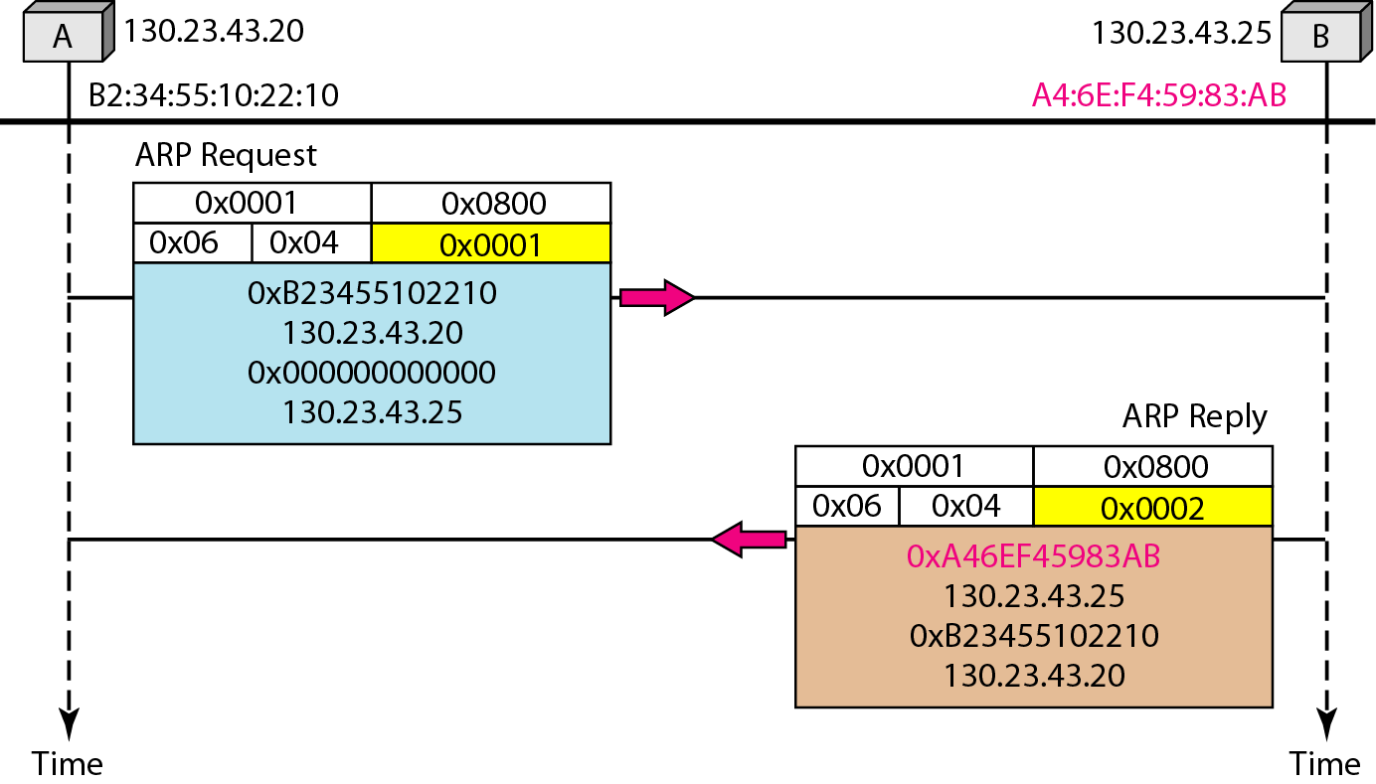
Figure 21.5 Example 21.1, an ARP request and reply

Slide 15
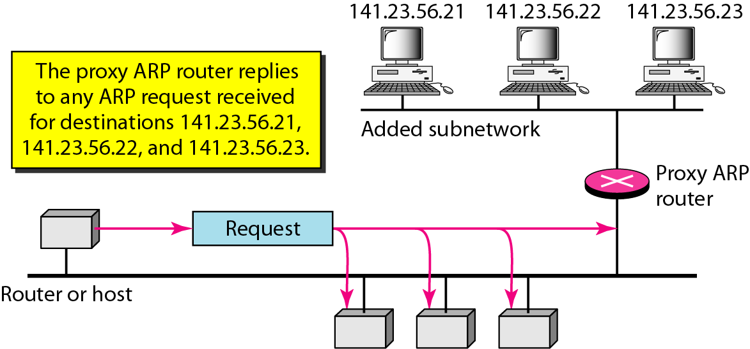
Figure 21.6 Proxy ARP

